Slide 1


Automotive Electronics Mini Project
GPS Based Position Monitoring using Ri-Pi
Presentation By:
Team No. 5 | PREETHISH K R | 4NM20EC074
 | RAKSHITH | 4NM20EC083
 | UJWAL N NAYAK | 4NM20EC135
Department of Electronics and Communication Engineering

Slide 2
1. Introduction
An In-vehicle monitoring system ,describes any electronic device that is used to track or report the vehicle position at that instant of time.
GPS-based position monitoring systems are very useful in variety of applications, such as tracking vehicles, monitoring the movement of goods , and tracking people in outdoor environment.
The project primarily focusses on finding the GPS parameters such as latitude and longitude of the current location continuously and displaying it in OLED display with the help of Raspberry Pi pico and a GPS module.
The software connected to the vehicle via Raspberry pi pico with GPS.
By combining the latitude and longitude any location can be pinpointed.

Slide 3
2. Literature Survey
Design of an Intelligent Navigation System Using Raspberry Pi Pico and GPS Module by K.K. Abidoye and A.A. Afolabi, published in the International Journal of Innovative Technology and Exploring Engineering (IJITEE). This paper proposes an intelligent navigation system that combines GPS, Raspberry Pi Pico, and additional sensors to provide real-time location tracking and direction information. It suggests that the Global Positioning System (GPS) is most widely used for the tracking purposes.
Raspberry Pi Pico and GPS Based People Tracker by C. W. Loke and A. K. Kamath, published in the International Journal of Engineering and Advanced Technology (IJEAT). This paper presents a people tracking system that uses Raspberry Pi Pico and GPS module to monitor the location of individuals in real-time.
Raspberry Pi GPS Tracking: Car Tracking System by Hafidz Zulkifli, published in the International Journal of Electrical and Computer Engineering (IJECCE). This paper presents a detailed design and implementation of a car tracking system using Raspberry Pi Pico and GPS module.

Slide 4
3. Block Diagram of the Proposed System
Raspberry Pi Pico
Power supply
LCD display
GPS Module

Slide 5
4. Requirements
Hardware Required:
Raspberry Pi Pico
Neo 6M GPS module
LCD display( OLED)
Jumper wires
Breadboard
Software Required:
Thonny IDE
Micropython

Slide 6
5.TECHNICAL SPECIFICATIONS
1)Microcontroller: Raspberry Pi Pico
Specifications:
RP2040 microcontroller chip
264KB internal ram
Input/Output voltage is fixed at 3.3V
2)GPS Module: Neo-6M
Specifications:
Supply voltage:3.3V
Baud rate: Configurable from 4800 to 115200 baud rates(default 9600)
Rechargeable battery for back up and EEPROM to save configuration settings
3)LCD Display: OLED
Specifications:
Require 3.3 V power supply

Slide 7
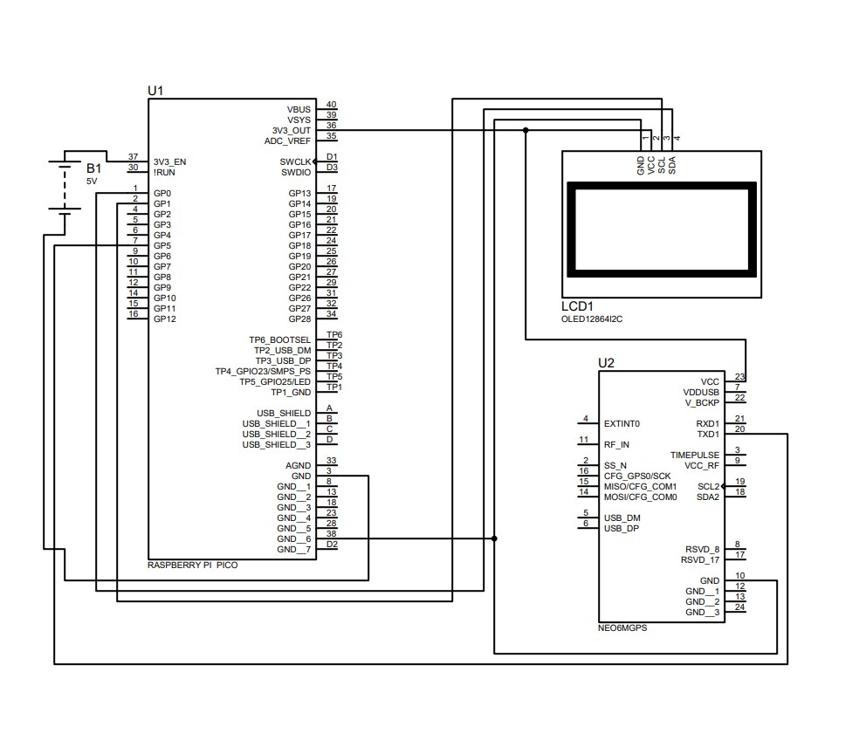
6.Design

Slide 8
7. FLOWCHART
GPS Antenna receives electromagnetic signals from satellites
Signals from satellites are converted to digital value by GPS chip
Digital values are fed to Raspberry pi pico
Processes and extracts the latitude, longitude and time information
Display GPS Parameters and time information in OLED display

Slide 9
8. Approximate Cost of the System
Serial No. | Components | Quantity | Approximate cost in (₹)
1 | Raspberry Pi Pico | 1 | 500
2 | Neo 6M GPS module | 1 | 500
3 | 128x64 OLED | 1 | 330
4 | Jumper wires | 10 | 50
5 | Breadboard | 1 | 100
 |  |  | Total cost= ₹ 1480

Slide 10
9. Market Availability
GPS-based position monitoring using Raspberry Pi Pico is a popular technology that has a wide range of applications in the market.
The global GPS position monitoring device has a market size worth USD 2,192 million in 2021. It was expected to be valued at USD 6,378 million by 2030.
The examples of the availability of this technology in the market are
GPS tracking devices: There are several GPS tracking devices available in the market that use Raspberry Pi Pico as the microcontroller. These devices can be used for vehicle tracking, asset tracking, and personal tracking. Some examples of these devices are the Trackimo GPS tracker, the Adafruit Ultimate GPS breakout board, and the Loco Positioning System.
Software solutions: There are several software solutions available in the market that provide GPS-based position monitoring capabilities using Raspberry Pi Pico. These solutions include web-based platforms, mobile applications, and desktop software that can be used to track the location of vehicles, assets, and individuals. Some examples of these solutions are Fleetio, GPSWOX, and Traccar.
DIY kits: There are several DIY kits available in the market that include Raspberry Pi Pico and GPS module, along with other components such as sensors, displays, and communication modules. Some examples of these kits are the Adafruit GPS HAT kit, the Spark Fun GPS kit.

Slide 11
10. Existing System
Raspberry Pi GPS Tracker: This is a DIY GPS tracker project that uses a Raspberry Pi Pico with a GPS module to provide real-time location tracking. It includes a web-based user interface for tracking the device.
Adafruit Ultimate GPS Logger Shield: This is a GPS logging shield for Raspberry Pi Pico that allows users to log GPS data and track their position over time. It includes a built-in SD card slot for data storage.
Vehicle Monitoring and Security System (VMSS): This is a GPS based vehicle tracking system that is used for pace and security application.
OpenPlotter: OpenPlotter is a free and open-source platform for marine navigation and IoT applications. It uses Raspberry Pi Pico with GPS and AIS modules to provide real-time position monitoring, weather data, and vessel information.
Navit: Navit is an open-source GPS navigation system that can be used on a Raspberry Pi Pico. It provides turn-by-turn navigation and real-time position tracking using GPS data.

Slide 12
11.Future Scope
Real time tracking of many vehicles has been made easier with the help of GPS technology. GPS positioning technology plays an important role in positioning, monitoring, and navigation
GPS based position monitoring using Ri Pi Pico has a lot of potential for future applications. The possible future scopes are:
Personal Navigation: GPS-based position monitoring can be used in personal navigation devices for tracking the position while driving, hiking, or walking.
Asset Tracking: GPS-based tracking can be used to monitor the location of valuable assets, such as construction equipment, shipping containers, and expensive merchandise.
IoT: GPS-based tracking can be integrated with other IoT devices to create smart city solutions. For example, it can be used to monitor traffic flow and optimize traffic lights for smoother traffic.

Slide 13
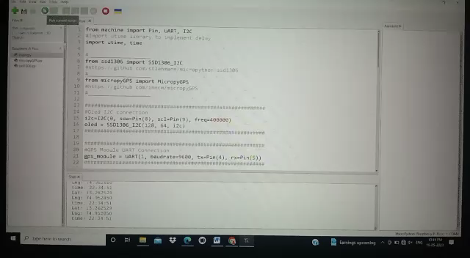
12. Demonstration Video

Slide 14
References
[1] Prashant A. Shinde and Prof.Mr.Y.B.Mane, “Advanced Vehicle Monitoring and Tracking System based on Raspberry Pi” IEEE Sponsored 9th International Conference on Intelligent Systems and Control (ISCO), 2015.
[2] Aburva Poongundran.A and Jeevabharathi.M, “Vehicular Monitoring and Tracking Using RASPBERRY PI”, International Journal of Innovative Research in Science, Engineering and Technology (IJIRSET). Vol. 4, Issue 2, Feb. 2015.
[3]https://ijisrt.com/wp-content/uploads/2018/01/Real-Time-Vehicular-Tracing-System-using-Raspberry-PI-1.pdf
[4]https://www.electronicwings.com/raspberry-pi/gps-module-interfacing-with-raspberry-pi
[5]https://circuitdigest.com/microcontroller-projects/raspberry-pi-3-gps-module-interfacing

Slide 15


